Slide 1
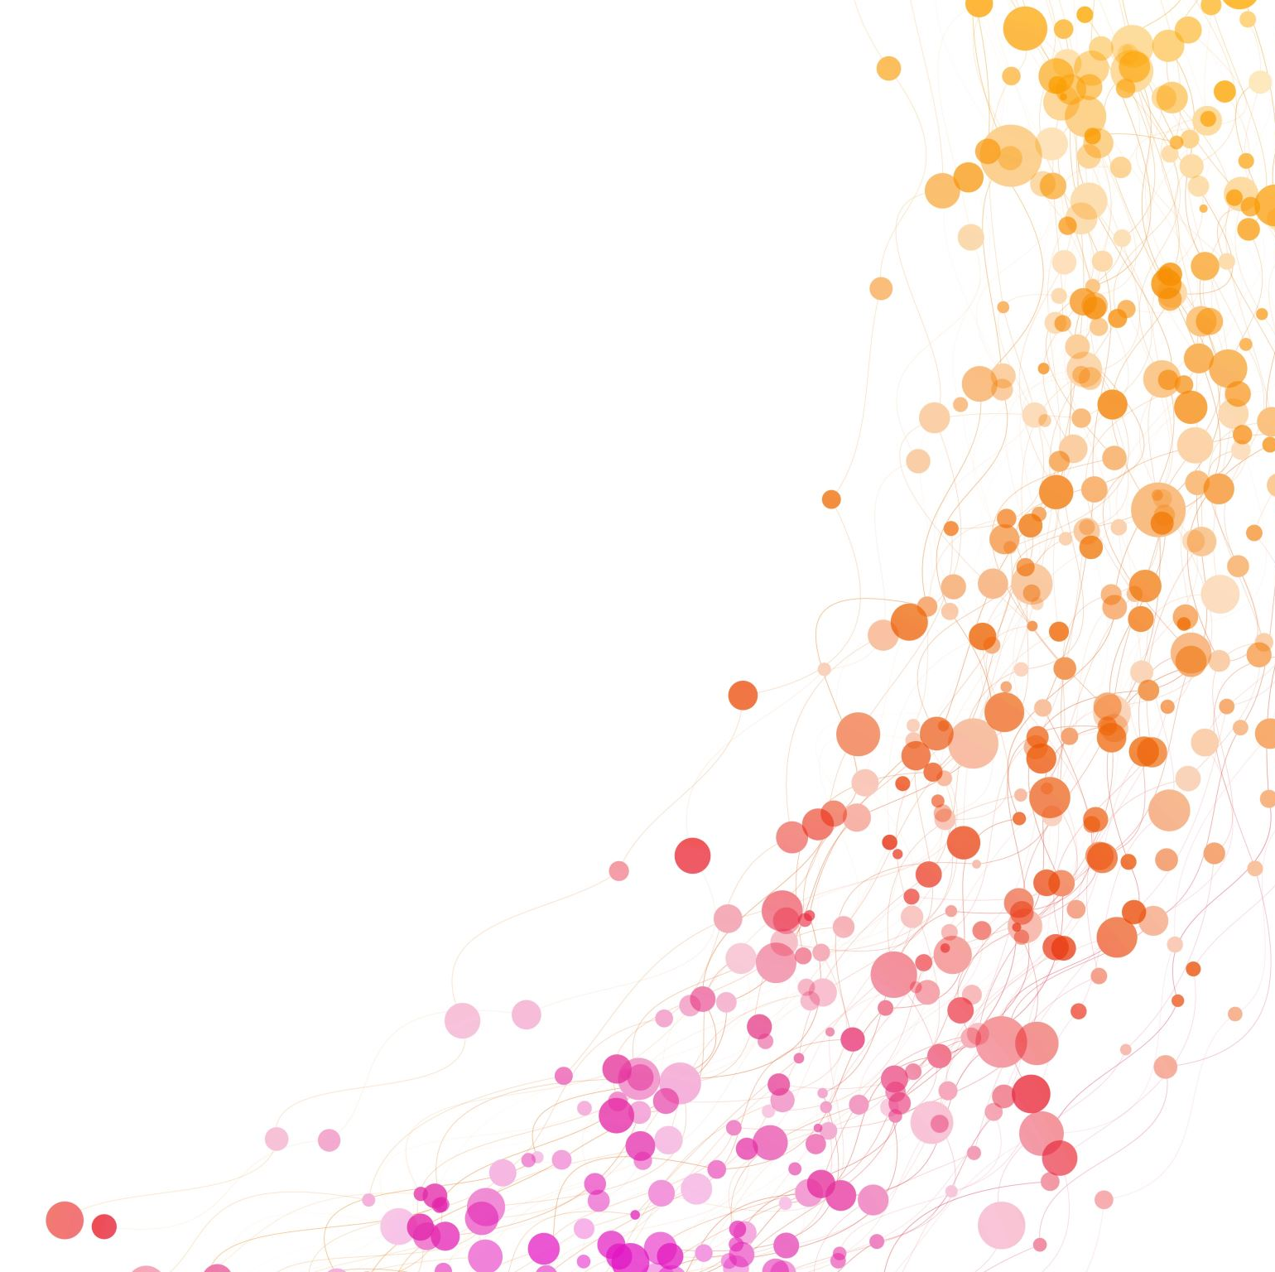
Suicide
Presented by -
Divyam(2021ME21076)
Saurabh (2021ME21099)
Rachit (2021ME10979)
Aryan (2021ME11000)

Slide 2

Definition
Suicide is the act of intentionally ending one's own life. It is a complex issue with various underlying causes, such as mental illness, trauma, and social isolation. Suicide can have a devastating impact on families, friends, and communities. It is a serious public health concern, and it is important for individuals at risk to seek professional help and support. If you or someone you know is struggling with suicidal thoughts, reaching out for help immediately is important. There are many resources available, including crisis hotlines and mental health professionals.

Slide 3
Contents
Farmer Suicides
Student/Youth Suicides
Suicide among women in India and China
Suicide related to financial crisis

Slide 4
Theories Analyzing Suicide Rates
Durkheim's Theory of Suicide: Emile Durkheim's theory of suicide suggests that social integration and regulation are crucial in determining suicide rates. According to Durkheim, individuals with weaker social ties and lower levels of social regulation are more likely to experience anomie (a state of normlessness or social disintegration). They, thus, are more likely to take their own lives.
Strain Theory: This theory emphasizes the role of social and economic strain in contributing to suicide. According to this theory, individuals who experience high levels of strain, such as poverty or unemployment, may be more likely to experience feelings of hopelessness and despair that can lead to suicide.
Social Learning Theory: This theory suggests that suicide can be learned through social interactions and modeling. Individuals may learn suicidal behaviors or attitudes from others, including family members, peers, and media representations of suicide.
Critical Theory: This theory emphasizes the role of power and oppression in shaping social conditions that contribute to suicide. According to this theory, suicide may be seen as a response to the oppressive conditions of capitalist society, including economic inequality, social injustice, and cultural marginalization.

Slide 5
Background and Significance of the topic
According to the World Health Organization (WHO), over 700,000 people die by suicide yearly, translating to one person every 40 seconds.
Suicide is the second leading cause of death among 15-29-year-olds globally, with 79% of suicides occurring in low- and middle-income countries.
Suicide not only impacts the mental health of individuals but also has a significant social and economic impact on families and societies.
Suicide prevention and awareness have become a pressing concern for policymakers, healthcare professionals, and communities worldwide.
This presentation explores various aspects of suicide, including the subtopics of farmer suicides, student/youth suicides, suicide among women in India and China, suicide related to the financial crisis, suicide rates in Indian states, and ritualistic suicide. By understanding these different facets of suicide, we can develop effective strategies to prevent suicide and support those struggling with suicidal thoughts or behavior.

Slide 6

Farmer Suicides

Slide 7
Relation with Durkheim theory
Emile Durkheim's theory of suicide suggests that suicide is not only a personal choice, but also influenced by social factors. He argued that suicide rates can be explained by the level of social integration and regulation in a society.
In the case of farmer suicides, Durkheim's theory may be applicable in the sense that these suicides are not solely the result of individual mental health problems or personal struggles, but are also influenced by social and economic factors that impact the farming community as a whole.
For example, farmers may experience social isolation due to the nature of their work and the remote locations of their farms. They may also face economic stress and uncertainty, particularly in times of drought or low crop yields. These factors can contribute to feelings of hopelessness and despair, which may increase the likelihood of suicide.
Therefore, it can be argued that Durkheim's theory is relevant to understanding the issue of farmer suicides, as it highlights the importance of considering broader social and economic factors in addition to individual factors when examining suicide rates.

Slide 8

Background
India is one of the world's largest agricultural economies, with over half of the population dependent on agriculture for their livelihood.
Farmers are the backbone of India's agriculture, contributing to the country's food security and economy.
Despite this, farmer suicides have increased in India, with over 300,000 farmers taking their own lives between 1995 and 2015.
It is a critical issue that requires attention and support from the government and society to address the root causes and provide necessary resources for farmers in distress

Slide 9
Reasons For Farmer Suicides
Inability to pay the debt
Lack of Proper irrigation
Green Revolution
Unfavorable government policies
Damaging of crops due to bad weather, pests(locust attacks)
Overdependence on monsoon
Expensive Technologies
Rising cost of cultivation
Unsatisfactory realization of prices in farming

Slide 10
Impact of Farmer suicide
Loss of sole breadwinner in the family
Another family member gets loaded with the burden of break earning
Impact on the children’s education
Other family members attempting suicide
Death of other family members
Fields, farms, and houses are confiscated
Family may become labourers or even beggars, etc.
Increase in child labour

Slide 11
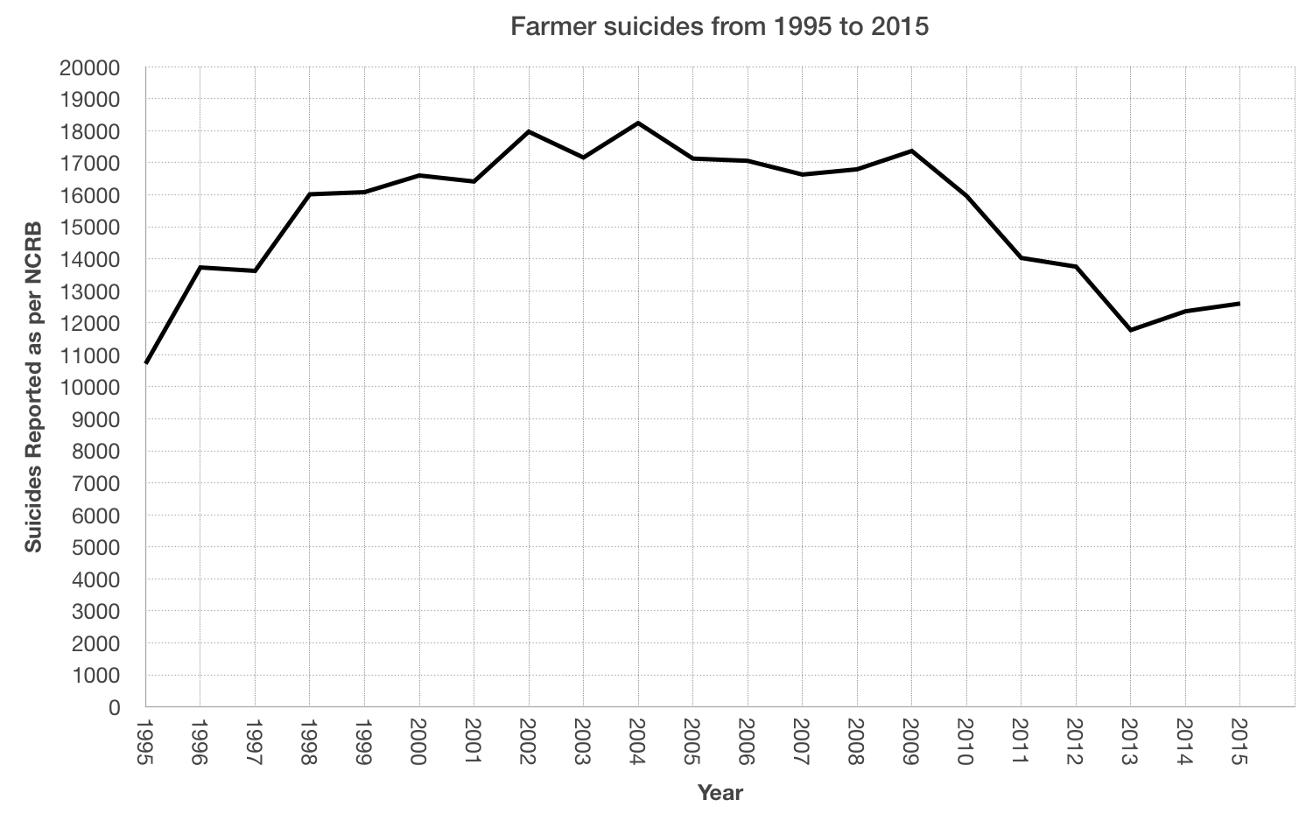
Stats about farmer Suicides
According to the National Crime Records Bureau (NCRB) data, 10,281 farmers died by suicide in India in 2019, accounting for 7.4% of all suicides in the country that year.
Maharashtra, Karnataka, and Andhra Pradesh reported the highest number of farmer suicides in 2019.
In addition to these economic factors, social and psychological factors such as social isolation, alcoholism, and mental health issues can also contribute to farmer suicides.
Latest reports of NCRB shows that farmer suicide increased from 10,677 in 2020 to 10,881 in 2021, accounting for 6.6% of the total of 1,64,033 suicides in the country.
Nearly 30 people in the farming sector die by suicide daily, typically due to overwhelming debt.
The problem of farmer suicide is not unique to India; other countries such as the United States and Australia, have also reported high rates of suicide among farmers in recent years.
Source: Wikipedia

Slide 12
Solutions
Education about farming techniques
Better access to loans and easy T&C
Pesticides, fertilisers at lower cost
Direct Subsidies
Revised Govt. Schemes
Insurance
Regulation of market
Watershed management

Slide 13

Student and Youth Suicides

Slide 14
Relation with Durkheim theory
In the case of youth and student suicide, Durkheim's theory may be applicable in the sense that these suicides are not solely the result of individual mental health problems or personal struggles, but are also influenced by social and cultural factors.
For example, students and youth may experience social isolation, pressure to succeed academically, or bullying from peers, all of which can impact their mental health and contribute to feelings of hopelessness and despair. Additionally, cultural attitudes towards mental health and seeking help may discourage young people from seeking support when they are struggling.
Therefore, it can be argued that Durkheim's theory is relevant to understanding the issue of youth and student suicide, as it highlights the importance of considering broader social and cultural factors in addition to individual factors when examining suicide rates. Addressing these social factors, such as increasing access to mental health resources and promoting a culture of openness around mental health, can be an effective way to prevent youth and student suicide.

Slide 15
Background
Student and youth suicides are a growing concern in many countries.
Academic pressure, competition, and expectations to excel in academics, extracurricular activities, and social life contribute to student/youth suicides.
Prevention strategies for student/youth suicides include early identification of mental health issues, strengthening support systems, promoting mental health awareness, and reducing academic pressure and stress.

Slide 16
Stats about Student Suicides
The Indian Institutes of Technology Joint Entrance Examination (IIT-JEE) is a highly competitive exam that is the gateway for admission to undergraduate programs at the Indian Institutes of Technology (IITs).
According to the Times of India, the suicide rate among IIT-JEE aspirants in India is high, with several cases reported yearly.
According to the All India Survey on Higher Education (AISHE), suicides among students pursuing higher education increased from 23 in 2014-15 to 110 in 2018-19.
According to the National Crime Records Bureau (NCRB), the suicide rate among students in India increased by 52% between 2014 and 2018.
The NCRB also reported 10,159 student suicides in India in 2018.

Slide 17
Stats about student suicides
There were 50 cases of suicide by candidates appearing for the Union Public Service Commission (UPSC) examination between 2013 and 2019. (India Today Report)
According to the World Health Organization (WHO), suicide is the second leading cause of death among individuals aged 15 to 29 years old
LGBT+ students are at a higher risk of suicidal ideation and suicide attempts due to discrimination and social isolation.
It is important to seek help if you or someone you know is experiencing suicidal ideation. Resources such as suicide hotlines, counselling services, and support groups are available to those in need.

Slide 18
Solutions to Student Suicides
Mental Health Support
Education and Awareness
Crisis Hotlines
Peer Support
Collaborative Efforts
Address academic pressure
Collaboration with parents and community

Slide 19

Suicide among women in India and China

Slide 20
Relation with Durkheim theory
In the case of women and suicide, Durkheim's theory may be applicable in the sense that these suicides are not solely the result of individual mental health problems or personal struggles, but are also influenced by social and cultural factors. Women may face particular social and economic pressures, such as gender-based discrimination, domestic violence, or unequal access to resources, that can contribute to feelings of hopelessness and despair.
Additionally, cultural attitudes towards gender roles and expectations may contribute to women's mental health struggles. For example, societal pressures to conform to traditional gender roles, such as being a caretaker or a homemaker, may limit women's opportunities and lead to feelings of powerlessness.
Therefore, it can be argued that Durkheim's theory is relevant to understanding the issue of women and suicide, as it highlights the importance of considering broader social and cultural factors in addition to individual factors when examining suicide rates. Addressing these social factors, such as promoting gender equality, reducing gender-based violence, and increasing access to resources for women, can be an effective way to prevent women's suicide.

Slide 21

Background
Suicide is a major public health issue in both India and China, with women being particularly at risk.
In India, suicide is the leading cause of death among women aged 15-39 years, with young married women in rural areas being the most vulnerable.
In China, suicide is also a major cause of death among women, with rates higher in rural areas than in urban areas.
The reasons for suicide among women in both countries are complex and multifaceted, including issues such as gender-based violence, societal pressure and discrimination, mental health issues, and lack of access to resources and support.

Slide 22
Reasons (India)
Domestic violence
Dowry harassment
Forced marriages
Honor killings
Sexual harassment

Slide 23
Reasons (China)
Gender-based discrimination and inequality
Mental health issues
Pressure to conform to societal expectations:
Economic pressures

Slide 24

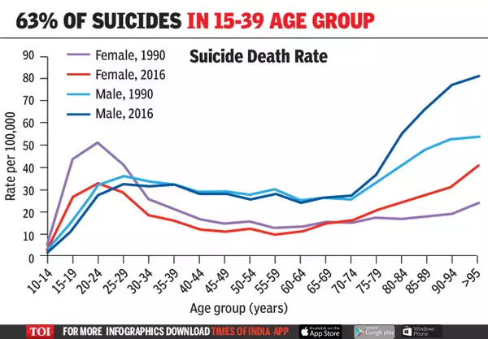
Statistics(India)
According to the National Crime Records Bureau (NCRB) report, in 2019, a total of 28,585 women died by suicide in India, which accounts for 30.1% of the total suicides in the country.
The suicide rate among women in India was 14.7 per 100,000 in 2019, compared to the global average of 7.7 per 100,000.
The highest number of women suicides were reported in the age group of 15-39 years, accounting for 67.2% of all female suicides in 2019.
The states with the highest suicide rates among women in India are Chhattisgarh, Tripura, and Tamil Nadu.

Slide 25
Statistics(China)
In China, marginally more women than men die by suicide each year. China is one of the few countries in the world that has a higher suicide rate by women over men. It was found that females that attempted suicide were less likely to have been diagnosed with a mental disorder
According to WHO’s stats: in 2016, the suicide rate in China per 100,000 people was 10.3 for women, one of the highest female suicide rates in the world
A 2008 study— which was based on data from the 1990—found that: female suicides outnumbered male suicides by a 3:1 ratio; rural suicides outnumbered urban suicides by a 3:1 ratio;

Slide 26
Solutions
Promote social support
Address the root causes of suicide
Increase awareness and education
Create safe and supportive environments
Address cultural and social norms

Slide 27
CONCLUSION
To summarize, suicide is a major problem, especially among farmers, young people, and women. Economic, social, and psychological issues are typically interconnected and contribute to suicide ideation and behavior.
Financial strain, unemployment, poverty, social marginalization, domestic abuse, and mental health concerns are all factors that can increase the risk of suicide for farmers, young people, and women.
Actions should be taken to raise public understanding of mental health issues, expand the availability of counseling and support services, strengthen economically disadvantaged communities, and tackle the underlying causes of social exclusion and discrimination.
Policymakers, civil society organizations, and other stakeholders must collaborate to create effective policies and programs to reduce suicide rates and aid individuals who have been affected.
We should all do all we can to make our society more welcoming and equal so everyone can find happiness and success. Working together, we can make suicide unthinkable.

Slide 28
BIBLIOGRAPHY
"Suicide among Women in India: A Study of Trends and Social Correlates" by Sutapa Agrawal, Suresh Kumar, and Akanksha Srivastava (International Journal of Social Psychiatry, 2018).
"Women's Suicide in Rural China: A Qualitative Study" by Li Xing and Xiaoshu Li (Women's Studies International Forum, 2019).
"Youth Suicide: Risk and Preventive Interventions" by Alexandra L. Fleischmann, Danuta Wasserman, and Benedikt Löwe (World Psychiatry, 2016).
"Student Suicide in Higher Education: Challenges and Opportunities for Prevention" by Eric C. Strain, Charles E. Sammons, and Samuel M. McLean (Harvard Review of Psychiatry, 2019).
"Farmers' Suicides in India: Magnitudes, Trends and Spatial Patterns" by K. Nagaraj and Srijit Mishra (Economic and Political Weekly, 2017).
"Causes of Farmers' Suicides in India: An Empirical Investigation" by Alok Kumar Pandey and Kumud Pandey (Journal of Developing Areas, 2017).
"Suicide Prevention" by the National Institute of Mental Health (NIMH).
"Understanding Suicide" by the American Psychological Association (APA).
"Suicide Prevention Lifeline" website and hotline.
10. NCRB’s ADSI Reports

